Slide 1
Beyond Risk: A Practical Guide to Ethical, Disability-Informed Suicide Prevention
LaVonne Fox, PHD,MOTR/L, Project Director for ND Thrives
April 9th, 2026
Collaboration for Change Webinar Series
ND Center for Persons with Disabilities

Slide 2
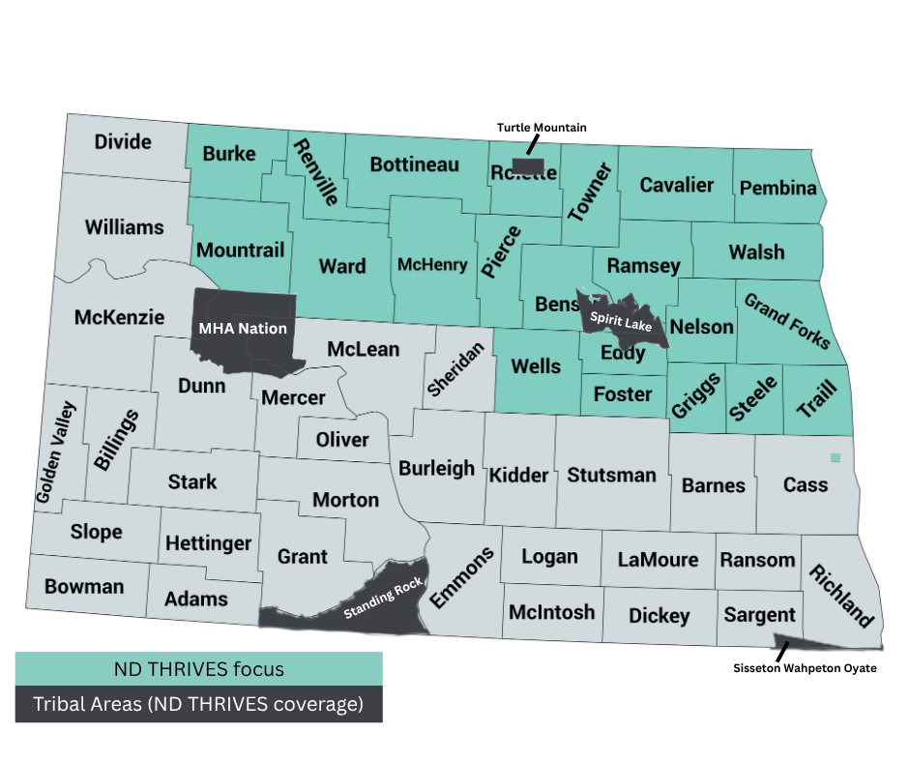
ND THRIVES Focus Area

Slide 3
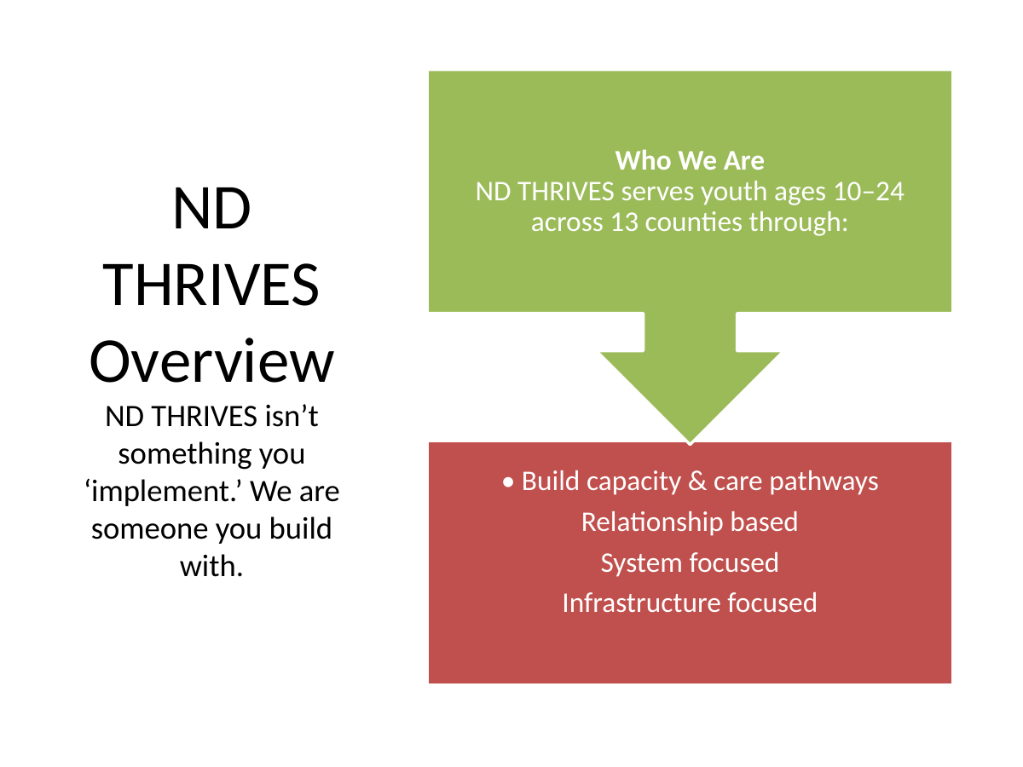

Slide 4
Learning Objectives
By the end of today’s session, participants will be able to:
Identify warning signs and risk factors.
Recognize how risk may present differently across disabilities.
Apply strength-based, culturally responsive approaches.
Know when and how to refer or respond.

Slide 5
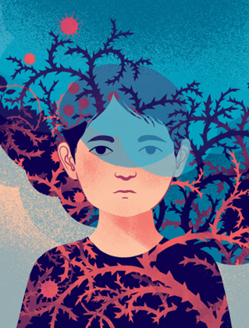
Why this Training Matters
Students with disabilities are not immune to suicide risk.
Risk is often overlooked or misinterpreted.
Trusted adults and professionals are often the first to notice changes.
Early connection builds safety, belonging, and resilience.

Slide 6

Why Your Role Matters
Trusted adults and professionals are the first line of defense.
Early recognition saves lives.
Disabilities can mask distress.
Every connection matters.
Connection is protection

Slide 7
Your Ethical Role
You are not diagnosing
You are not providing therapy
You ARE responsible for:
noticing
asking
connecting
Following protocol is ethical care
Bottom line:
➡️ You are part of a system of support—not the only support

Slide 8
Common Myths About Suicide & Disability
Myth | Reality
Students with disabilities don’t understand suicide. | Many understand distress, death & hopelessness -
Suicide prevention is the counselor’s job. | Trusted adults are often the first to notice and connect.
This is just behavior or acting out. | Behavior is often communication of distress
If we talk about suicide, it will put the idea in their head. | Asking directly reduces risk and opens the door to support
➡️ Taking students seriously and asking directly can save lives

Slide 9
What the Data Tells Us
📊 Students with disabilities are at significantly higher risk
3–9x higher rates of suicide attempts compared to peers
Up to 40%+ of youth with intellectual/developmental disabilities report suicidality
Early risk can appear in childhood, including in autism
Risk increases with complexity (communication, cognitive, medical needs)
➡️ Disability does not protect against suicide risk—it can increase vulnerability

Slide 10
Context Matters:
How Risk May Present Differently
🧠 Mental Health Factors Depression → withdrawal, low energy, hopelessness Anxiety → avoidance, overwhelm, shutdown Trauma responses → reactivity, unpredictability | 🧩 Disability Context Distress may be expressed behaviorally or nonverbally Communication differences may mask intent Changes from baseline are key signals
♿ Lived Experience Factors Feeling like a burden Social isolation or exclusion Chronic pain or fatigue Barriers to accessing support | ➡️ Risk is not always obvious—it must be interpreted within context

Slide 11
Common Risk Factors
Withdrawal from favorite activities or peers
Increased irritability, aggression, or defiance
Unusual quietness or emotional “shutdowns”
Regression in skills (communication, toileting, academics)
Refusal to use assistive or communication devices
Key Messages:
🌀 Behavioral shifts may signal internal distress—not “acting out”
🌀 What matters most is what’s different for that student

Slide 12
Communication & Engagement Changes: Warning Signs
Watch for changes in how a student communicates and connects:
Statements about hopelessness, death, or wanting to disappear
Negative self-talk (“I’m a burden,” “No one likes me”)
Drawings, writing, or online content expressing distress
Decline in participation, attendance, or effort
Avoiding peers, staff, or previously safe spaces
Loss of interest in activities that once brought joy
Key Messages:
💬 Distress may be expressed through words, behavior, or withdrawal
🌿 Disconnection is a major warning sign

Slide 13
Physical, Emotional &
Nonverbal Signs of Distress
Distress may show up in the body, behavior, or communication patterns:
Fatigue, restlessness, or frequent physical complaints
Changes in sleep, appetite, or energy
Increased visits to nurse without clear cause
Self-injury or unsafe behaviors
Loss of communication skills or regression
Increased shutdowns, sensory avoidance, or withdrawal
Key Messages:
💡 Distress may appear physically before it is spoken
🌀 Students may communicate distress nonverbally or indirectly
🌀 Notice patterns—what’s different from their usual way of being
So, if distress doesn’t always look clear--and we know it often doesn’t -- the next step is knowing when to ask directly.

Slide 14
When Do You Ask About Suicide
Expressions of hopelessness
“I’m a burden” or “I don’t matter”
Sudden behavior or mood changes
Escalating distress or withdrawal
Significant loss or disruption
If suicide crosses your mind as a possibility, that is enough reason to ask.

Slide 15
Asking Does NOT Increase Risk
It reduces isolation
It communicates safety
It allows support to begin
Silence is more dangerous than asking.

Slide 16
It’s Not About Functional Level
Suicide risk is not limited to “high functioning” individuals
Avoid assumptions about understanding
Adapt to communication—not ability
Distress exists across all disability types

Slide 17
How To Ask (Adapted Language)
Verbal:
“Are you thinking about killing yourself?”
“Are you thinking about suicide?”
Intellectual / Developmental:
“Are you thinking about hurting yourself on purpose?”
“Have you thought about trying to die?”
Autism:
Be literal
Avoid metaphors
Limited verbal:
Yes/No
AAC / visual supports
Burden:
“Sometimes when people feel like a burden, they think about suicide—has that happened for you?”

Slide 18
If They Say Yes
Stay calm
Thank them for telling you
Do not leave them alone (if immediate concern)
Follow school protocol
Contact support team
Document
Use supervision
You are a connector—not the sole responder.

Slide 19
When to Escalate
Escalate immediately if a student reports or shows:
Plan- → “I know how I would do it”
Intent → “I want to die” or “I’m going to do it”
Access to means - → Pills, weapons, or other method available
Timeline → “Soon,” “today,” or a specific time
Prior attempts → Especially recent or increasing in severity
Sudden calm after distress → May indicate a decision has been made
➡️ Do not leave the student alone—follow your school’s crisis protocol immediately

Slide 20
Responding to Risk:
Your Role as an Educator
You don’t need to diagnose — just connect and communicate.
✅ Notice
Pay attention to changes from a student’s baseline
Trust your instincts — if something feels “off,” pause and look closer
Behaviors that look like refusal, withdrawal, or escalation may signal distress
Behavior is communication.” Your awareness can open the door to safety.
❤️ Connect
Approach with warmth, curiosity, and no judgment
Use simple, supportive questions:
  “I’ve noticed you seem different lately — how are you feeling?”
  “Is there anything that’s been hard for you?”
Offer calm presence; students often respond to tone more than words
If you are concerned about suicide, ask directly using clear, simple language.

Slide 21
Responding to Risk
📎 Refer
Follow your school or district’s crisis protocol
Notify the counselor, school mental health team, or administrator
Do not leave the student alone if there is immediate concern
Document concerns as required
Your job is to connect them to support, not carry it alone.
🤝 Support
Maintain connection after referral — even small check-ins matter
Reinforce belonging: “I’m glad you’re here. You belong with us.”
Celebrate strengths and coping skills
Follow-through communicates care, stability, and safety.

Slide 22
What Protects
💖 Connection & Belonging Positive peer and educator relationships Feeling included and valued in the classroom community Supportive family or caregiver engagement Belonging is the foundation of safety — when students feel seen, heard, and valued, they are more likely to reach out for help. | 🌱 Cultural & Community Strengths Participation in cultural or spiritual practices Access to Elders, mentors, or supportive community programs Opportunities to contribute and lead within their community using their strength. Affirming cultural identity fosters pride, belonging, and purpose — all powerful protectors against suicide risk.
🧠 Coping & Problem-Solving Skills Explicitly teaching emotional regulation and coping strategies Encouraging self-advocacy and use of communication supports When students learn to express feelings, solve problems, and ask for help, they build confidence and resilience that protect against crisis. | 💪 Consistent Support Systems Predictable routines and trusted adults Early intervention and accessible school-based services Collaboration among trusted adults and professionals, counselors, and families When students know who is in their circle of care and what to expect, they feel safer, more connected, and more capable of reaching out for help.

Slide 23
How You Build
Protective Environments
Your presence and environment can reduce risk and build safety:
Promote inclusion and peer belonging
Use strength-based language
Model empathy and respect
Provide flexible communication options
Partner with families and community support
🌿 Belonging is protection—students who feel seen and valued are more likely to reach out

Slide 24
Case Reflection
Scenario:
A 5th-grade student with autism begins refusing to use their communication device and isolates at recess.

Slide 25
Referral and Support Pathways
Review school/district suicide response protocols.
01
Discuss collaboration between teachers, special trusted adults and professionals, counselors, and families.
02
Share 988 Suicide & Crisis Lifeline and local crisis resources.
03
Emphasize the importance of follow-up and maintaining connection.
04
This is where your responsibility transitions—you are not carrying this alone.

Slide 26
Crisis Support
🚨 911 for emergencies
📞 Call 988 or chat at 988lifeline.org for suicide intervention & crisis support
💬 Crisis Text Line: Text HOME to 741741
🏳️‍🌈 The Trevor Project – Support for LGBTQ+ youth
📲 ND 211 – Call for information & community resources

Slide 27
Key Takeaways
✅ Risk looks different — learn each student’s baseline.
✅ Strengths matter — relationships protect.
✅ You are a connector, not a clinician.
✅ Always take concerns seriously and refer.
➡️ What you notice and how you respond can change outcomes

Slide 28
Disclaimer & Funding
This presentation was developed under the ND THRIVES Garrett Lee Smith (GLS) grant, supported by the Substance Abuse and Mental Health Services Administration (SAMHSA), U.S. Department of Health and Human Services (HHS), Grant No. SM-22-003.
The views expressed are those of the presenter and do not necessarily reflect the official policies or positions of SAMHSA or HHS. No official endorsement by SAMHSA or HHS is intended or implied.
Materials are in the public domain unless otherwise noted and may be reproduced with appropriate citation. Distribution for a fee requires written permission from ND THRIVES. For additional information, contact lavonne.fox@und.edu
Notes:
Rachel

Slide 29


Slide 30

Thank You

