Slide 1

Positive Behavior Support
PBS
.51
Melody Baker,
Staff trainer, Kalix
January 2023

Slide 2

Positive Behavior support
Positive Behavior support is a specific way to support people based on:
Respect for the person
Belief that behavior is a Choice
Functional Behavior Assessment

Slide 3

Functional
Behavioral
Assessments
Functional behavioral assessments should answer the question:
“What is the person getting out of doing this behavior?”

Slide 4
Behavior Observation
It is important to use descriptive language when discussing behavior to help everyone understand exactly what is occurring.
specific observable behavior examples:
  kicking
  slapping
  banging the head on the table

Slide 5
Functional Behavior Assessment
Functional Behavior Assessment may include:
    Observation of the person
    Medical assessment and Review of records
    Interviews with staff and others who know the person well.

Slide 6

Data Collection
Data Collection for Functional Behavior Assessment may include:
  Frequency recording – documenting each time a specific behavior occurs
  Interviews
  ABC recording – before, behavior, consequence including what is going on and who is present when the behavior occurs

Slide 7

Behavior Observation
ABC Recording
  Antecedent – refers to what happens right before the target behavior
  Behavior – refers to what the person said or did (the observable and measurable behavior)
  Consequence – refers to what happens immediately after the target behavior

Slide 8
data
ABC data helps us discover if events, conditions in the environment, or staff responses could be making that behavior more likely to occur.

Slide 9

data
Collect data according to the directions provided by the coordinator or supervisor. Ask them to explain when the directions are not clear.

Slide 10


reinforcer
A reinforcer is something that increases the occurrence of the behavior.

Slide 11
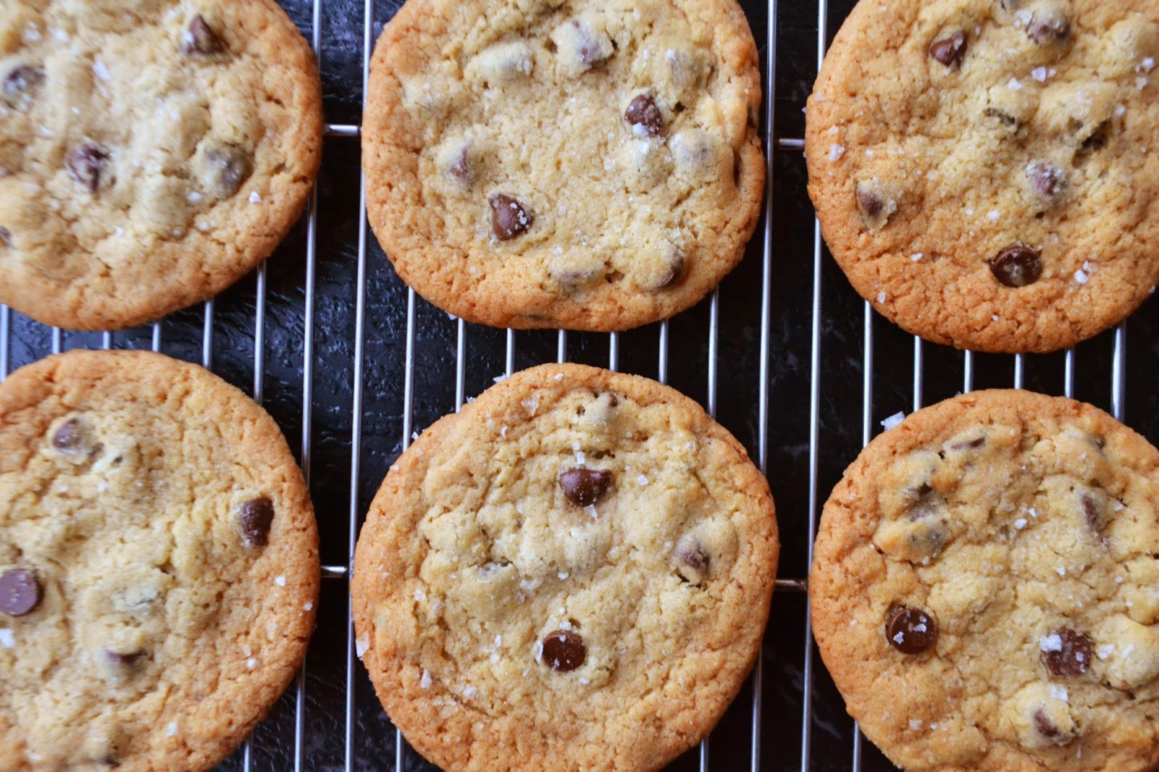
reinforcer
Natural reinforcers
  Getting to eat a cookie after baking it
  Smelling good after taking a shower
  Feeling good about completing challenging work
This Photo by Unknown Author is licensed under CC BY-SA-NC

Slide 12

Teaching replacement skills is an important part of PBS.
PBS avoids the use of restricting rights

Slide 13

The person should be learning new skills in order to be more successful or more independent in the community and with people important to them

Slide 14
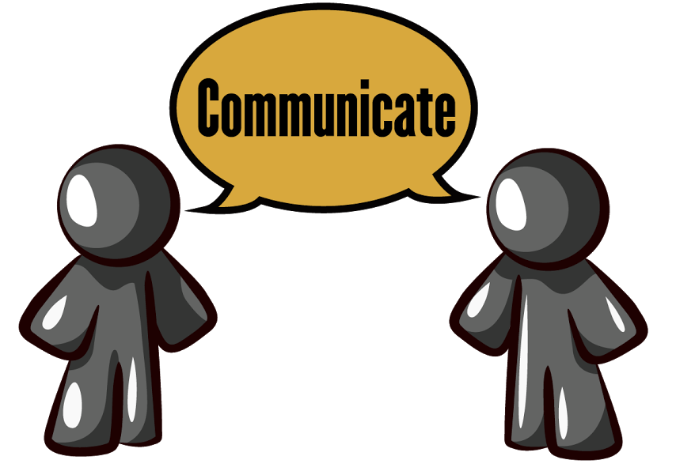
Communication
Challenging behavior is communication

Slide 15
Positive and Encouraging Environments
State
State your verbal instruction in a positive way
Make
Make your statements as clear as possible
State
State positive consequences whenever possible

Slide 16
Positive and Encouraging Environments
Have
Having positive expectations of people can boost their self esteem
Be
Consider
Be an appropriate role model
Consider your tone of voice in giving instructions

Slide 17
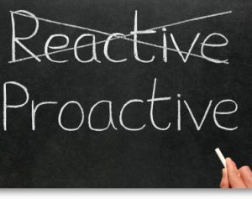
Be PROACTIVE
  Creating or controlling a situation by causing something to happen rather than responding to it after it has happened
  Using what we know about people to assist in preventing challenging behavior
  Using a checklist is being proactive.

Slide 18

Self-talk - verbalizing what you think to yourself during a situation
  Proactive or preventive strategy
Social skill autopsy – talking with a person after social interactions to help the person improve their ability to use social skills.
  Used after the person has used or failed to use the social skill.

Slide 19

Social article/story is used to practice and predict what will happen if appropriate behavior is practiced.

Slide 20
Shopping at the Grocery Store
A Social Story

Slide 21
Today I am going to the grocery store. There are a lot of aisles and choices there, and sometimes I do not know where to look for the things I need.

Slide 22
Being confused or unsure of where to look for something is not a bad thing –it just means that I need some help to find what I need.

Slide 23
I can ask someone who works at the grocery store to tell me where I can find something.

Slide 24

Social skills
Effective social skills instruction includes helping people learn what to do rather than what not to do.

Slide 25
Social Skills
Social skill deficits can be a result of not having opportunity to learn & practice social skills.

Slide 26
Ways People Gain More Control in Their Lives
Communicate preferences
Knowledge of options available
Know how to pursue their preferences.
Understanding the differences between opportunity and risk.
Know how to problem solve and learn from mistakes.
Feeling good about oneself.

Slide 27

DSPs should provide opportunities for people to learn to make responsible choices.

Slide 28

Limiting choices
Limiting choices may be appropriate if the person's behavior is likely to:
Threaten the health or safety of the person
Threaten the health or safety of others
Interfere with the rights of others

Slide 29
To help determine when a challenging behavior needs formal intervention:
Does the behavior:
threaten the physical well-being of the person?
interfere with acceptance by peers without disabilities?
result in destruction of property?
become more serious if there is no intervention at the present?
threaten the physical well-being of others?
interfere with the person’s ability to learn, and progress in obtaining their goals?

Slide 30
Staff should practice how to respond to challenging behavior:
  It will help to be prepared if challenging behavior occurs
  Reduces the possibilities of abuse
  May prevent the challenging behavior to escalate.

Slide 31
  Extinction – not acknowledging the behavior
  Reinforcing effective alternative behavior
  Extinction is only effective if everyone involved consistently withholds the reinforcer.

Slide 32

Interrupting technique: get the person to think about something else
This Photo by Unknown Author is licensed under CC BY

Slide 33
Prepare yourself to disengage
Breathe deeply
Respond in a neutral, calm voice
Keep responses brief
Avoid reacting to baiting remarks
Respond appropriately
Mentally and physically
Focus on the message behind the behavior
Avoid power struggles

Slide 34
Informed Consent – must be obtained for behavior intervention that restricts rights
Any restriction must be approved by the human rights committees
Least Restrictive Alternative: If restrictions are in place, we want to use the least restrictive least intrusive action.
Blocking a hit in an emergency situation does not require prior approval from the human rights committee.

Slide 35
Punishing is never a good idea.
Forces people to adapt rather than find a more appropriate behavior.
Does not teach appropriate behavior.
Places barriers in the way of building relationships
Sometime produces aggression in the person being punished.
Does not produce generalized results.

Slide 36
Let’s discuss
What is a quality environment?
What are positive and proactive things we could do if someone doesn’t want to do their household chores?

