Slide 1
Intro to Autism
.58
Melody Baker,
Staff trainer, Kalix
February 2023

Slide 2
Umbrella term for a group of disorders
Autism affects skills in 3 overall areas
Social skills and interactions
communication
behavior

Slide 3
It is important to identify Autism as early as possible.
There may be delays in language.

Slide 4
Common learning characteristics:
Inability to understand body language, tone of voice or expression
Difficulty with change in routine

Slide 5
Common learning characteristics:
Difficulty noticing important cues
Difficulty with unstructured time and waiting.

Slide 6
Common learning characteristics:
Benefit from information presented visually
Can learn and repeat lengthy routines

Slide 7
Common learning characteristics:
Concentrate on narrow topics of interest
Benefit from predictable routines that have a clear beginning and end

Slide 8
Common learning characteristics:
Respond well to key words and simple phrases
They have the ability to remember things for a long time

Slide 9
People with Autism can go to college

Slide 10
Teaching social skills:
Create
create opportunities for interactions
Include
include DSPs, coworkers, families in teaching social skills

Slide 11
Teaching social skills:
Use
use scripts to teach social skills
Use
Use direct instruction methods first to increase the opportunity to practice the social skill.

Slide 12
Teaching social skills:
Social stories are written from the point of view of the person with Autism.
Use visual supports for social rules

Slide 13
Typical characteristics of communication abilities:
May have large vocabulary but unable to carry on a conversation.
Use the same words or phrases repeatedly and/or repeat what others say

Slide 14
Typical characteristics of communication abilities:
Facial expressions and gesture may not match what the person is saying
It can be difficult for them to understand why others are upset

Slide 15
support communication
Make
Make instructions specific
Modify
Modify instructions to match the person’s ability to understand.
Combine
Combine verbal directions with visual supports (e.g., photos, gestures)

Slide 16
support communication
Use
Use pauses to allow the individual to process and respond to requests.
Use
Use normal tone of voice and intonation

Slide 17
It’s important to teach an appropriate way to communicate when there is a need to decrease inappropriate speech.

Slide 18
Rules
Set a rule when it is okay and not okay to talk about something and when it isn’t.
Example: it is okay to talk about soccer at lunch time, but not during work time

Slide 19
Challenging behaviors:
almost always serve a function or purpose
may be triggered by overuse of words such as no, don’t, or wait
Are often reinforced by their consequences.
behavior

Slide 20
Critical components in a behavior support plan
Changes are made to the environment
Teaching new behaviors to replace the challenging behavior
Plan to reinforce the appropriate behavior
behavior

Slide 21
Critical components in a behavior support plan
Plan for responding if the challenging behavior occurs
Plan for keeping people safe if the challenging behavior puts anyone at risk of harm
behavior

Slide 22
Behavior Interventions
there is not a single approach that works best for all people.
Critical to identify and use interventions that have the best chance of leading to positive outcomes.
People are not motivated by the same things
behavior

Slide 23
Behavior Interventions
Some interventions are supported by research, some are not.
Information found in scientific research studies reported in peer referenced journals can usually be trusted.
behavior

Slide 24
Discrete Trial Training
Highly structured teaching strategy in which a teacher uses a series of learning opportunities called trials to instruct a person.
Discrete trial consists of a teacher/support provider asking the person for a specific behavior (Sara, pick up the soap).
Each trial is “discrete” because it has a define beginning and end

Slide 25
Discrete Trial Training
Support provider breaks down task into small, simple trials
Correct responses are immediately followed by meaningful reinforcers and social praise
Effective reinforcers for one person may be offensive to another person.

Slide 26
Discrete Trial Training
Prompts and support providers change over time to promote generalization
Practicing in a variety of settings is a critical part of teaching
Support provider pauses briefly between trials

Slide 27
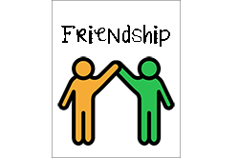
Friendship
Model respect and acceptance
Assist the person to learn and use basic social skills
Arrange opportunities for friendships to occur
Focus on finding friends who have similar interests

Slide 28
Friendship
Provide the person with Autism with specific prompts and reinforcement for friendship skills
Provide supports to the individual with Autism in naturally occurring activities

Slide 29
Young adults need info about sexuality and relationships to keep them safe

Slide 30
People with Autism might have these medical issues
Seizure Disorders
Sleep Dysfunction
Eating Issues
Effective medical management is important for people with Autism

Slide 31
Motor skills
A person with Autism may have poor gross motor skills but good fine motor skills

Slide 32
Therapies
Occupational Therapy
Physical Therapy
Speech Language Therapy
Embed therapy within natural activities in a natural environment
Therapy

Slide 33
Employment

Slide 34
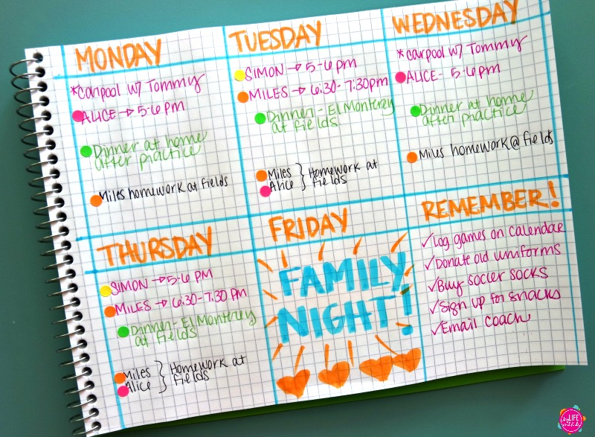
When a person has difficulty with completing tasks:
Use visual schedule
Ask the person to repeat directions
Use “first (this), then (that)” statements
Teach in real life situations.

Slide 35
Reasons for negative employment outcomes:
Work readiness requirements prevent people from learning in the natural setting
Many people have limited understanding of autism
Employers fail to identify necessary supports
Person’s preferences haven’t matched the job.

Slide 36
Environmental Adaptations

Slide 37
Adaptations and individualized supports are as important to a person with Autism as eye glasses to people with visual impairments
Adaptations

Slide 38
When the person needs sameness or has difficulty with transitions
Define specific areas in the setting using furniture or dividers
Keep setting consistently organized
Assign a designated seat
Post daily schedule in a consistent location
Use a visual agenda
Adaptations

Slide 39
When the person needs sameness or has difficulty with transitions
Define specific areas in the setting using furniture or dividers
Keep setting consistently organized
Assign a designated seat
Post daily schedule in a consistent location
Use a visual agenda
Adaptations

Slide 40
When the person is distracted by sensory input
Adaptations
Position the person in low traffic areas
Install carpeting
Face desk/work station away from windows and doors
Cover the computer and other materials when not in use
Seat the person away from distracting items in the setting

Slide 41
When the person is distracted by sensory input
Avoid touching the individual at first
Teach tolerance to appropriate touch
• Verbally reinforce the individual for increased tolerance to appropriate touch
Adaptations

Slide 42
When the person is distracted by sensory input
Avoid using heavy perfumes or lotions
Seat the individual near an open door or window
• Use unscented cleaning supplies
• Verbally reinforce the individual for increased tolerance to loud noises
Adaptations

Slide 43
When the person is distracted by sensory input
Lower the light levels
• Turn off overhead lights (especially fluorescent)
Adaptations

Slide 44
When the person is distracted by sensory input
Try different colored lights
Have the individual wear sunglasses or a baseball cap
• Use bulbs that do not flicker
Adaptations

Slide 45
Challenges

Slide 46
To reduce auditory distractions:
• Provide a noise canceling headset
• Use sound absorption panels
• Provide a white noise machine
• Place employee’s workspace away from auditory distractions
Concentration Challenges
This Photo by Unknown Author is licensed under CC BY-SA

Slide 47
To reduce visual distractions:
• Use cubicles
• Reduce clutter in the employee’s workspace
• Place employee’s workspace away from visual distractions
Concentration Challenges

Slide 48
When the person has difficulty organizing and prioritizing work:
Color‐code systems for files, projects, or tasks
Provide written or picture checklist of tasks
Post visual charts to identify daily work tasks
• Teach and reinforce organization skills
• Ask a co‐worker to help the employee

Slide 49
Social Skills Challenges

Slide 50
When the person has difficulty with their behavior on the job:
• Post rules and policies of conduct
• Provide concrete examples of inappropriate social skills
• Provide concrete examples to explain consequences
• Use training videos to show appropriate workplace behaviors
• Reinforce appropriate social skills

Slide 51
When the person has difficulty with appropriate Interactions
Provide a mentor to help the employee
Make attendance at social functions optional
• Encourage co‐workers to have personal conversations away from work areas

Slide 52
When the person has difficulty with impulsiveness
Provide frequent breaks
Teach and reinforce self‐management techniques to control impulsivity
Allow the employee to work from home
Post work rules and conduct policies
Provide a private workspace

Slide 53
When the person has difficulty Managing Stress
Allow a modified work schedule
Reinforce the employee’s use of appropriate stress management techniques
Provide time for the employee to call or e‐mail others for support

Slide 54
Examples of visual supports
reminders
Rules posted on walls or desks
Rules written on the front of a notebook
Work checklist
Reminder cards with short phrases like “If I need help, I can….” or “Remember to say ‘hi’ to three people in the break room”.

Slide 55
People with Autism might have difficulty understanding cues for break time at work

Slide 56
If a person becomes upset at work, a designated area to calm down is helpful

Slide 57
Self-Determination
Self determination is when a person is involved in making his or her own decisions for a quality life in the future. It involves making one’s own life choices, setting personal goals, and developing a plan of action to achieve those goals.
This Photo by Unknown Author is licensed under CC BY-NC-ND

Slide 58
The living arrangement most responsive to the needs of people with autism is when the person makes decisions about who they live with and who provides support.

