Slide 1
Achieving Personal Outcomes
.18
July 2023
Melody Baker, Staff trainer Kalix

Slide 2
Personal outcomes
Goals
Learning
Prompts
Reinforcers
Active Support

Slide 3
Personal Outcome Measures
POMs
There are 21 personal outcomes

Slide 4
PERSONAL OUTCOME MEASURES
People are safe
People are free from abuse and neglect
People have the best possible health
People experience continuity and security
People exercise rights
People are treated fairly
People are respected
MY HUMAN SECURITY

Slide 5
PERSONAL OUTCOME MEASURES
People use their environments
People live in integrated environments
People interact with other members of the community
People participate in the life of the community
MY COMMUNITY

Slide 6
PERSONAL OUTCOME MEASURES
People are connected to natural support networks
People have friends
People have intimate relationships
People decide when to share personal information
People perform different social roles
MY RELATIONSHIPS

Slide 7
PERSONAL OUTCOME MEASURES
People choose where and with whom they live
People choose where they work
People choose services
My Choices
My Goals
People choose personal goals
People realize personal goals

Slide 8
Outcomes are different for everyone
Changing behavior is not necessary to achieve outcomes

Slide 9
Goals

Slide 10
Priorities:
Goals related to life, safety, health, rights, or protection from harm.
Skills that will improve the person’s quality of life.
Things the person supported wants or needs to learn.
Goals that support people to be an accepted member of their neighborhood and/or community.
Skills that help people have better relationships with others.

Slide 11
Important foundational beliefs in helping people reach their goals:
#1- ability to achieve goals depends on the agency’s ability to provide services
#2 – outcomes are achieved with respect for a person’s legal rights and human dignity.

Slide 12
Learning

Slide 13
All people can learn
People with disabilities, including significant intellectual disabilities, can learn complex skills when they receive effective teaching, support, and opportunities to practice.

Slide 14
The only times it would be appropriate to do a task for an individual rather than teaching the person the skill is in an emergency or a high-risk situation.

Slide 15
form and function

Slide 16
Function is what needs to be done

Slide 17
Form is the way something can be done.

Slide 18
Example
Function: We all need to eat.
Form:
buy ingredients and cook a meal
order takeout
eat at a restaurant
eat last night’s leftovers
microwaveable meals
frozen pizza

Slide 19
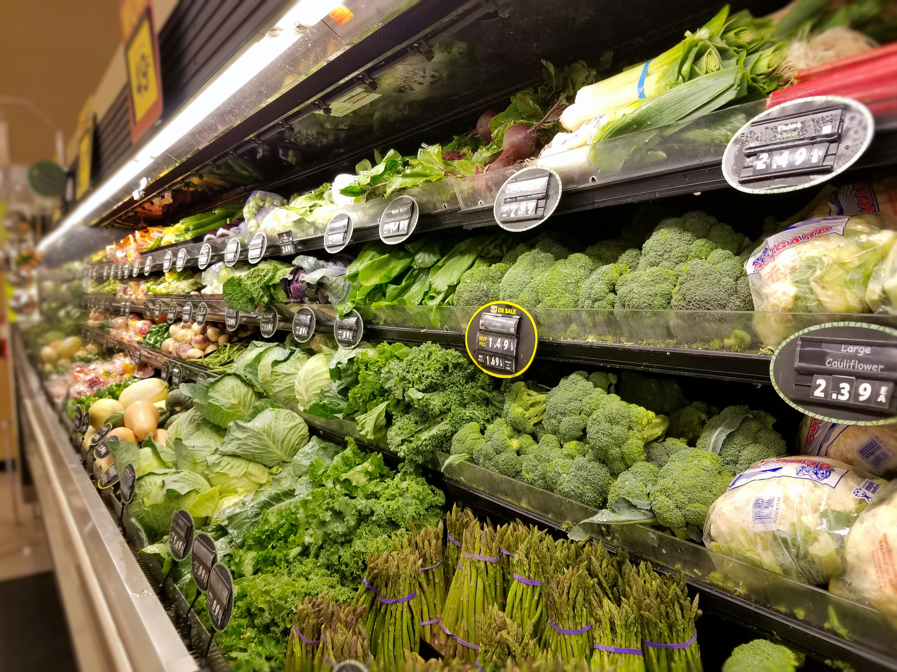
Effective Teaching strategies:
People with ID learn better in the actual setting where the skill needs to occur using the actual tools.

Slide 20
Effective Teaching strategies:
Wait until the person is paying attention to the task before beginning to teach.
Minimize distractions in the environment (turn off TV or music).

Slide 21
Effective Teaching strategies:
Help people figure out their own answer to problems, instead of telling people what to do.
The person supported should have choice and control in all learning situations.
When possible, allow the learner to complete a task the way they prefer to do it.

Slide 22
Effective Teaching strategies:
Use visual prompts like pictures and actual objects to help the person better understand and remember.
Teach and practice using real materials while the person is learning the skill.

Slide 23
Effective Teaching strategies:
Include teaching in many day-to-day activities and as opportunities happen
Believe that the person can be successful and ask for suggestions if they are having difficulties.

Slide 24
Effective Teaching strategies:
Break tasks into smaller steps and give one instruction at a time.

Slide 25
Natural supports :
Neighbors
Friends
Family
Church members
Coworkers
Fellow club members

Slide 26
Task analysis: Step by step instructions
Step by step instructions, helps people with intellectual disabilities learn because it is easier to learn a series of small steps one at a time, than it is to learn the whole task all at once

Slide 27
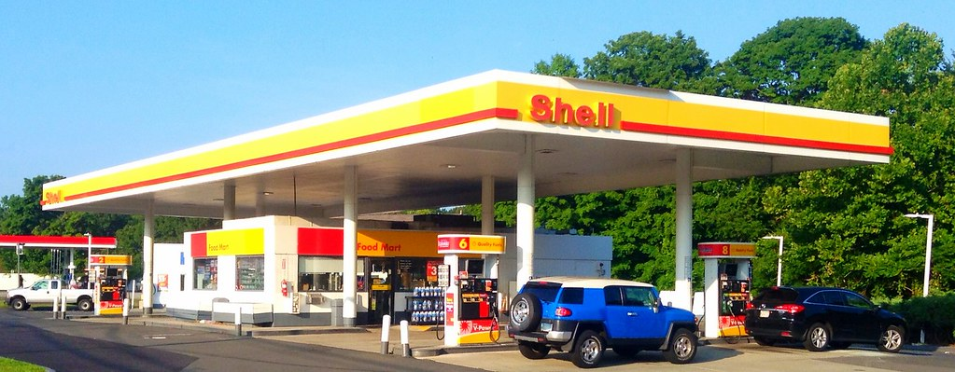
Pumping Gas
Open gas cap
Put debit card in slot
Follow prompts on screen
Push button on gas pump
Put gas hose in gas tank
Squeeze handle to allow gas to enter tank

Slide 28
Generalization
The person can use a learned skill in a variety of settings.
For example, if they learned how to put in gas at one gas station, they can put in gas at any gas station.

Slide 29
Error free learning –
staff step in to help the person before they make a mistake.

Slide 30
Potential Problems with “error free learning”:
Staff may get into the habit of over-prompting just to get things done quickly.
Too many prompts can be confusing or annoying to the learner.
A person may become “prompt-dependent” and unable to initiate tasks themselves.

Slide 31
Informal teaching:
something learned during a day-to-day activity.

Slide 32
Prompts: brief cues (instructions) used to help the learner know what is expected and how to do each step.

Slide 33
Types of prompts:
Visual cues: Object, picture, or icon that signals a person the next step.
My Visual Schedule
Time | Weekdays
7:00-8:30AM | Wake up Morning Routine Eat Breakfast
8:30AM-12:00PM | Work at Day Hab
12:00-1:00PM | Deliver Meals on Wheels
1:00-2:00PM
2:00-2:30PM | Relax and Snack
2:30-3:00PM | Physical Activity
3:00-3:30PM | Relax/My Activities
3:30-4:30PM | More Activities
4:30-5:00PM | Activities of Daily Living
5:00 PM

Slide 34
Types of prompts:.
Physical: Hand-over-hand assistance
Gestural: Pointing at, tapping, or touching the correct choice.

Slide 35
Types of prompts:
Modeling: Demonstrating something then waiting for the learner to imitate it.
Verbal: Short direct verbal cues or instructions.

Slide 36
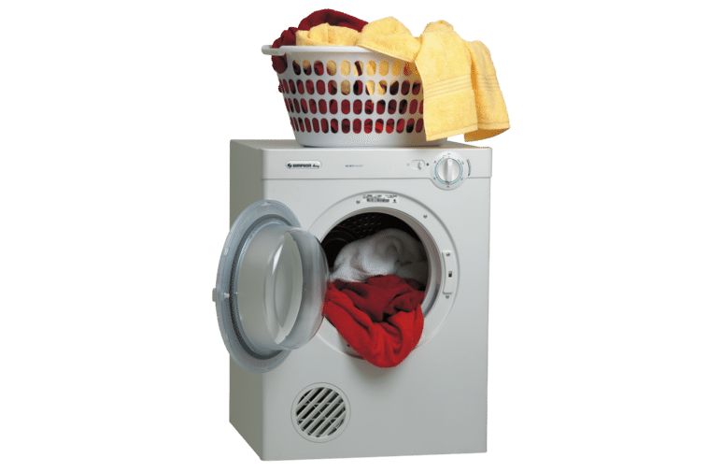
Natural Cue: Signal that would occur naturally in the setting.
natural/environmental cues:

Slide 37
When deciding which kind of prompt to use:
Wait to see if the person will need a prompt
Begin with the least amount of assistance and increase if needed
Use the strategy you think will work best, based on what you know about the person and the task

Slide 38
When helping a person learn a new skill…
best prompts for correcting mistakes:
usually best to let them try on their own to see if they will need prompts.
“Try this” and show them what to do.

Slide 39
When someone is learning a new skill at a job or in the community, staff should use the type of prompt that will attract the least amount of attention to the person and still be effective.

Slide 40
Fading: gradual elimination of cues, prompts and assistance.
As the learner is able to perform more skills on their own, prompts from staff should be faded.

Slide 41
Coordinators are the ones who write teaching plans
DSPs cannot make changes to the teaching plan on their own.

Slide 42
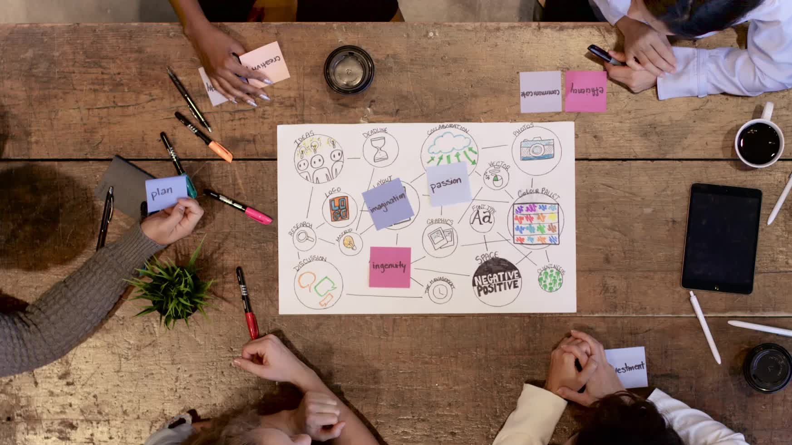
DSPs should talk to their supervisor about the teaching plan when:
The plan is not working as designed.
There are barriers to following the teaching plan as written
The person being supporting does not feel empowered by the plan or is resisting the plan
You don’t feel good about implementing the plan as designed, it doesn’t feel right

Slide 43
Data
Data tell us if teaching plans are useful and the person is making progress.

Slide 44
Reinforcement occurs when the teacher pairs something the learner wants with a desired behavior to increase the behavior.
Reinforcers

Slide 45
A reinforcement is something a person likes well enough to change his or her behavior.

Slide 46
Reinforcers
To find out what is reinforcing to someone:
Ask the person
Ask someone who knows the person
Observe the person
Try reinforcers that similar people enjoy

Slide 47
Reinforcers
Age-appropriate reinforcers help people fit in and be accepted by others in their community.
.

Slide 48
Reinforcers
The sooner a reinforcer follows a behavior, the more the behavior will be strengthened.
Paying attention can be a reinforcer and may accidentally strengthen inappropriate behavior.

Slide 49
Anything that cannot be legally withheld from a person cannot be used as a reinforcer.
(food, water, shelter, mail, community access, phone, etc.)

Slide 50
Extinction
Extinction or planned ignoring is used to decrease problem behaviors by not bringing attention to them. Many problem behaviors have been learned because they have been reinforced in the past. Usually “attention” is the reinforcer the person is trying to get.

Slide 51
Extinction
Guidelines for using extinction
Pick a new behavior to reinforce while the problem behavior is placed on extinction
Be consistent
Remember only the person’s problem behavior is on extinction. The person is not ignored. Only the behavior.

Slide 52
Extinction
We can’t use extinction for all behaviors. It would be neglect to ignore fighting or self-abuse if people will get hurt.

Slide 53
Many people with ID have trouble understanding:
cause and effect (one thing happens because of the other)
Pronouns I, you, me, they
Prepositions (above, behind, inside, over, under)

Slide 54
Many people with ID have trouble understanding:
Time concepts
Long sentences

Slide 55
A long list of choices may be confusing for someone with intellectual disabilities.
This Photo by Unknown Author is licensed under CC BY-SA-NC

Slide 56
DSPs

Slide 57
relationships matters
Building relationships takes time.

Slide 58
DSPs provide most of the support to people receiving services.
People supported can be affected by the language, actions, and attitudes of their DSPs.

Slide 59
The best teachers are those who find a way to make a connection with the learner. When learners trust the teacher and believe the teacher cares about them, learning improves. As people develop trust, they are more willing to try new things and skills increase.

Slide 60
If people associate you with pleasant events and happy memories, they will want to spend time learning with you. They will trust that what you ask of them will be good for them.

Slide 61
Caring relationships don’t just take time, they take the right kind of time. People receiving support should look forward to your coming to work because they know you are happy to be there. Good relationships develop through repeated pleasant experiences.

Slide 62
Caring is a very important, but caring isn’t enough. Sometimes staff get too emotionally involved and assume a parenting relationship. You might say they “care too much.” When this happens, it is easy for staff to start “doing for” rather than “doing with” the person and helping them to be engaged and exercise choice and control.

Slide 63
Keys to Building a Good Relationship
Spend time doing things the person likes to do.
When possible, help the person to avoid things that are disliked.
Learn to communicate well with each other.
The American Association on Intellectual and Developmental Disabilities (2004)

Slide 64
Active Support

Slide 65
People with disabilities benefit from being actively engaged in all aspects of their daily life as well as in the community. One of your most important roles with people you support is to provide active support to people throughout each day.

Slide 66
The core elements in the definition of Active Supports are helping people to be actively, consistently, and meaningfully engaged in their own lives regardless of their support needs.

Slide 67
Be Engaged – Doing things, participating, spending time with others, making decisions, making choices.
Actively – Each day, throughout the day whenever there is an opportunity.
Consistently – With approaches that provide enough structure and routine that people experience comfort, continuity, and have a better ability to be engaged.

Slide 68
Meaningfully – in ways that
increase competence and opportunity
help people be and stay connected to others
provide enhanced self-esteem
are focused on needs, preferences, and goals of the person

Slide 69
In every activity throughout each day, look for opportunities for the people you are supporting to participate. People should not sit and watch while you do things for them. They can and should actively participate in their lives at some level that is appropriate for them

