Slide 1
Promoting Nutrition and Wellness for Persons with Developmental Disabilities.
895.45
July, 2015
NDCPD

Slide 2
What is Wellness?
Lesson 1

Slide 3
Wellness defined
Traditionally, wellness was thought of as the absence of disease.
Big problem with this – wellness and disability cannot coexist!
We now focus on defining it as “the best possible functioning of each individual.”
This means that health/wellness is a way to attain a quality of life, not a goal in itself.
We all define it differently – it is individualized.

Slide 4
Dimensions of Wellness
Physical Wellness
Emotional/Psychological Wellness
Spiritual Wellness
Social Wellness
Intellectual Wellness
Occupational/Career Wellness
Physical
Career
Emotional
Wellness
Intellectual
Spiritual
Social

Slide 5
Health and Wellness Among Persons with Disabilities
Lesson 2

Slide 6
Health Threats
High rates of emergency room visits and hospitalizations for their primary condition
Low rates of formal patient education
Low rates of treatment for mental illness
Activity limitations and difficulties with personal care
Preventable secondary conditions
Early deaths from their primary condition
Early deaths from co-morbidities
Less health insurance than general population
Higher rates of chronic conditions than general population
Lower rates of social participation than general population
Lower rates of recommended health behaviors than general population

Slide 7
Health Promotion
Promotion of healthy lifestyles and environment
Prevention of health complications
Preparation of the person to understand and monitor own health
Promotion of opportunities for life activity participation

Slide 8
How do People with Disabilities Define Wellness?
Both physical and mental states of well-being.
Includes:
Ability to perform necessary and desired activities
Independence and control of own life
Opportunities for self-determination
Not being held back by pain

Slide 9
Promoting and Maintaining Health and Wellness
Develop self-acceptance and coping strategies
Stay active
Contribute through paid work or volunteering
Set person goals
We need to assume that people with disabilities can lead healthy and independent lives and are the best managers of their own health.

Slide 10
Finding and Assessing Online Information
Getting people information about their own health helps them gain more power and control.
There is a lot of information out there and it can be overwhelming.
We need to ensure that the information we are sharing is valid and reliable.

Slide 11
Nutrition
Lesson 3

Slide 12
What is Good Nutrition?
It is crucial to eat a diet containing all the nutrients your body needs to provide energy and maintain good health.
Bodies need food from a variety of sources to accomplish this.

Slide 13
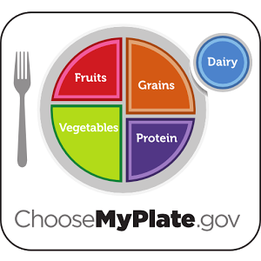
MyPlate: Let’s eat for the Health of It
We need to choose foods from the 5 food groups each day.
MyPlate is something from the USDA to help us visualize this.
It is important to build a healthy plate
Make half your plate fruits and vegetables
Switch to 1% or skim milk
Make at least half your gains whole grains
Vary your proteins
Keep your food safe to eat
Cut back on foods high in solid fats, added sugars, and salt
Eat the right amount of calories

Slide 14
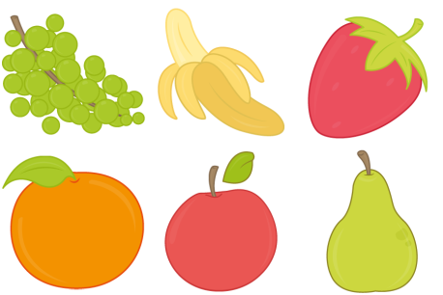
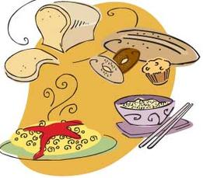
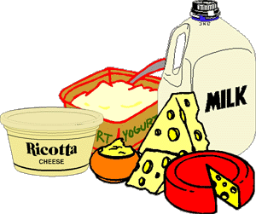
The Food Groups
Fruits
2-4 servings per day
Vegetables
3-5 servings per day
Grains
6-11 servings per day
Protein foods
2-3 servings per day
Dairy
2-3 servings per day
Fats, Oils, & Sweets
Use sparingly

Slide 15
Finding Balance
Eating well is not the only component for health – exercise is equally as important.
Exercise helps you balance the calories you take in.
You should do moderate to vigorous exercise for at least 30 minutes daily.
Children and teens should be active for at least 60 minutes daily

Slide 16
Make your food count
There’s a right amount of calories for each person to eat daily.
It’s easy to use up all allotted calories on a few items, so choose wisely.
Keep this in mind when eating out or out of town.
Also, check Nutrition Facts Labels when shopping.
Look at serving size, calories, carbs, fats, and sodium

Slide 17
Food Safety
Safe food is food that poses little risk of food borne illness.
Where you get food plays a role but we also need prepare and store foods safely.
Clean
Separate
Cook
Chill
Follow the label
Serve safely
When in doubt, throw it out.

Slide 18
Nutrition Needs of Individuals with Developmental Disabilities
Lesson 4

Slide 19
Nutritional Needs
The nutritional needs of those with and without developmental disabilities are vary similar.
However, some people with DD may have more complex or specialized needs.
Obesity is common
Some people do not get enough calories/nutrients.
Se Table 1 for examples of common nutrition issues.

Slide 20
Minimizing the risk
We can minimize nutritional risks through the team considering the following:
Training in wellness for both the person and staff
Positive behavioral supports to encourage a healthy lifestyle
Modifications to increase meal experiences and physical activity opportunities
Plans to teach skills
Adaptive equipment
Special nutrition products and formulas
Involvement of specialists

Slide 21
Impact of Medications
Common medications people with I/DD take may effect their nutritional status over time.
Common side effects are:
Changes in the sense of taste
Decreases or increases in appetite
Dry mouth
Nausea or vomiting
Diarrhea or constipation
Interference with the way the body absorbs vitamins or minerals.
Be sure to talk to the doctor/pharmacist/nurse and follow the medication labels to decrease the change of side effects and interactions

Slide 22
Concerns
Dental
Provide plenty of liquids
Limit sticky foods
Brush after eating
Maintain of a diet of varied easy to eat foods
Gastrointestinal
Rumination
GER
Constipation
Diarrhea
Underweight/Undernourished

Slide 23
Eating Difficulties
Food textures and consistency
Oral hypersensitivity
Therapy for problems
Tube Feedings

Slide 24
Meeting the Needs of Seniors
Aging affects most parts of the digestive system.
See table on page 37
Some things we can do:
Provide soft, easy to chew foods
Ensure good dental hygiene
Serve small, frequent meals
Serve the large meal early in the day
Create a relaxed atmosphere
Increase liquids, fruits, vegetables, and grains
Increase exercise
Avoid foods with seeds
Refrain from regular use of enemas or laxatives
Consider texture and consistency of foods.
Mealtime considerations
Texture & Consistency

Slide 25
Promoting Physical Activity and Wellness in Persons with Developmental Disabilities
Lesson 5

Slide 26
Benefits of Exercise
Weight control
Reduce the risk of other conditions
Help reduce blood pressure
Increase stamina and muscle strength
Increase flexibility
Reduce symptoms of anxiety and depression
Increase self-control
Enhance self-esteem
Enhancing the perception of others
Supporting personal fulfillment

