Slide 1
Maintaining Health & Wellness
895.44
NDCPD
July 2012

Slide 2
Lesson 1: The Power of Observation in Maintaining Health
A. What is Health?
  More than absence of disease
  Positive concept
  Physical health good body health as result of what?
  Mental health emotional and psychological well-being. What does this mean to you?
  Health changes over time. How?

Slide 3


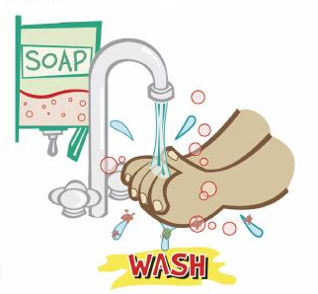
B. Health Promotion
  Nutrition
  Strong Social relationships
  Exercise
  Hygiene & Infection Control
  Stress Management
  Health Care
  Public Health Policies & Practices

Slide 4

C. Observational Mind-set
How do people who can’t talk tell you that something is wrong?
It’s very important that we develop a keen observation sense. Know what the person is like by using:
visual sense
auditory
smell
touch

Slide 5

DSPs become the eyes, ears, & nose for the supervisor, nurse, or doctor.
Take a look at questions on page 9

Slide 6
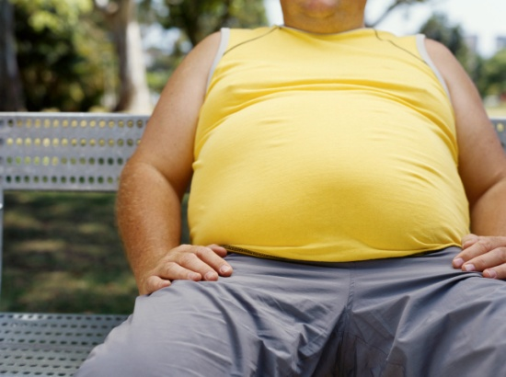
D. Health Status Indicators
Usually give more info to doctor/nurse than just a written report
      Health Related Habits like smoking, drinking, lack of exercise
      Sleep – any changes in pattern or time
      Eating and Weight – changes that may occur over time

Slide 7

Descriptive Language
  Leaves little room for interpretation
  Goes back to the ‘English’ classroom
  Which is descriptive?
    Al was aggressive today.
    Al hit the wall with his right fist.
  How can we make this ‘descriptive’?
  Henry isn’t feeling well today.

Slide 8
F. Assisting with Health Appointments
You may need to assist with a wide range of supports with health appointments.
Be sure to support the individual to do as much for them selves as possible and to take an active role in the appointment.
Be sure to help them prepare for the appointment.
After the appointment, rely the information to all those concerned and help ensure the Doctor’s recommendations are followed.

Slide 9
G. Assisting with Adaptive Equipment and Therapies
The main forms of intervention are:
  Physical Therapy
  Occupational Therapy
  Speech Therapy
As a DSP, you may have many roles when supporting people who need Adaptive Equipment or therapy sessions.

Slide 10
Lesson 2: Body Systems
Illness is the opposite of health
  How?
Illness affects the body as well as the mind
  How can an ulcer for example, affect the mind?

Slide 11
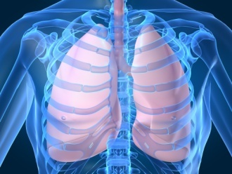
Body Systems Summary
Respiratory & Circulatory
  Heart, lung, nose
  Transfer food & oxygen to cells, removes toxins
Gastrointestinal
  Mouth, stomach, intestines, liver, pancreas
  Breaks food down so it can be absorbed

Slide 12

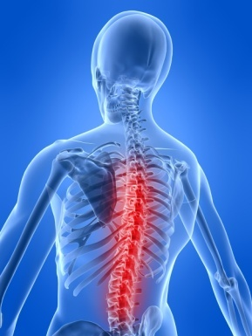
Systems cont.
Genitourinary
  Kidneys, ureters, bladder, urethra, testes, ovaries
  Urinary- filters blood, stores and eliminates waste
  Organs of reproduction
Nervous
  Brain, spinal cord, nerves
  Control & regulate all other systems

Slide 13
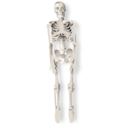
Body Systems (cont.)
Muscular/Skeletal
  Muscles, tendons, cartilage, bones, connective tissue
  Support & protect organs & help with movement
Skin & Sensory Organs
  Skin is largest organ / protective cover
  eyes, taste buds, olfactory system are senses

Slide 14
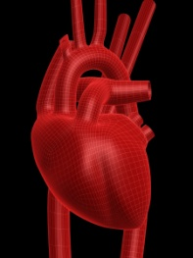
A. Respiratory & Circulatory System
Heart & vessels, lungs, nose
  Transfer food (nutrients) & oxygen to cells
  Removes toxins from body
Chronic conditions include
  cardiac disease, asthma, allergies,
Things to monitor
  Breathing, runny nose/congestion, coughing, sore throat, allergic reaction, edema, chest pain, symptoms of heart attack, stroke
When to call 911

Slide 15

B. Nervous system
Brain, spinal cord, nerves
  Regulate all other systems
Things to monitor (pp 19-22)
  Seizures (individualized), delirium (confusion), dizziness, fainting, headaches, head injuries, insomnia, level of consciousness, paralysis, tremors

Slide 16
D. Gastrointestinal system
Mouth, stomach, intestinal track, pancreas, liver
  Breaks down food so it can be used by the body
  Rids body of solid wastes
Things to monitor
  Know the person well
  Appetite, mouth & teeth, heartburn & gas, nausea & vomiting, abdominal discomfort, stood (feces), constipation, diarrhea (different from loose stool), hemorrhoids, poisoning

Slide 17

E. Genitourinary System
Urinary = kidneys, ureters, bladder, urethra
Genital = testes & ovaries - reproduction
Regulates balance of liquids taken in and eliminated
  Average daily intake and output = 3 ½ quarts
Things to monitor
  Urinary tract infections (UTI), urine, painful urination, discharge (drainage), genital itching, dehydration, sexual organs for males and females

Slide 18
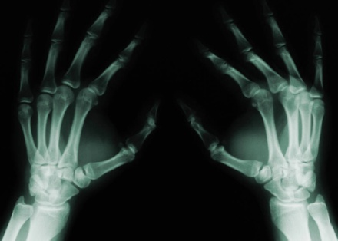
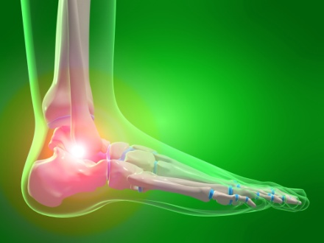
F. Musculoskeletal/Skeletal System
Muscles, cartilage, tendons, bones, connective tissue
  Framework of body, support & protection, mobility
Things to monitor
  Unusual gait, muscle tone, sprains, strains, fractures, pain or swelling in the joints

Slide 19
G. Skin
Largest organ of the body
Protective covering over entire body
Faster a new symptom develops, the more urgent the problem – see a doctor
Wounds = cuts, scrapes, punctures
  Abrasion= outer layer of skin worn away
  Cut= layers separated
  Laceration=torn or jagged wound
  Puncture= usually closes – high risk of infection

Slide 20

Skin cont.
Wound infection – some populations are at higher risk to develop infection – who?
Things to monitor:
  Pain, swelling, redness, warm to touch, pus, elevated temp
Human & Animal bites
  Rarely fatal
  Check bite characteristics

Slide 21
Skin cont.
Burns:
  What are some ways people get burned?
  Never use ointment unless Dr says so
  Things to monitor: (pp 32)
    Red and painful,
    Blistering
    Skin charred or crusted
    What was the cause

Slide 22

Skin cont.
Chills/Cold Extremities:
  Caused by rapid muscle contractions & relaxing
  Way for body to generate lost heat
What to monitor (pp 32)
  Body temp, is shivering involuntary, frequent chills, how long does it last, skin color, what is the outside temp, how is the person dressed, is there an elevated temp, what other symptoms

Slide 23
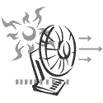
Skin cont.
Frostbite: damage to skin & tissues due to cold
Who is more susceptible:
What to monitor (pp 33)
  Environment, clothing, condition of skin
Heat:
  Heat cramps, heat exhaustion, heat stroke
  Body becomes overheated
  What is our policy? (pp 33)

Slide 24
Skin cont.
Insect bites & stings
  Most reactions are not serious
What to monitor
  Itching, swelling, fever, hives, joint/gland pain
  When should you call 911?
Rash
  Irritated or swollen skin
What to monitor (pp 33-34)
  Redness, itchy, bumpy, scaly, crusty, blistered, color, body part involved, exposure to ?
  Reaction times vary with type of irritant

Slide 25

Skin cont.
Fever
  Normal body temp is 98.6°F
  So… what’s different? (pp 34)
Skin Color Changes
  What’s normal for this person? (pp 34)
Other Skin Changes (pp 34-35)
  Is it part of the aging process?
  New growth?
  Sores heal properly?

Slide 26
H. Sensory Organs
Ears
  Tinnitus – ringing in the ears
  Meniere’s disease – fluid in the inner ear
  Symptoms? (pp 35-36)
Eyes
  Diabetes is the #1 cause of blindness in US
  Pain, redness, changes in vision
  Symptoms? (pp 36)
Nose
  Filters air, warms & moistens it
  After age 50, taste and smell diminish
  (pp 37)

Slide 27

Lesson 3: Reporting
Life Threatening (pp 44)
  When should you seek immediate medical help?
Reporting Health Threatening Situations
  Contact supervisor & Use common sense
Pay attention to what you see & hear
  Like what?
Pain Threshold
  Different for everyone
Communicating Illness
  How do people tell others they aren’t well

Slide 28
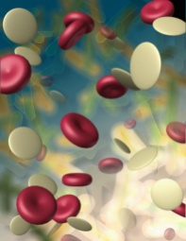
Lesson 4: Infection Control
Infectious Process: 4 components (parts)
  Invading organism: virus, bacteria, fungus, parasite
  Host: provides a place to live and multiply
    Humans, animals, non-human/non-animal (dirt)
  Method of Escape: respiratory tract, intestinal, genitourinary tract, blood or body fluids, skin break
  New vulnerable host:

Slide 29
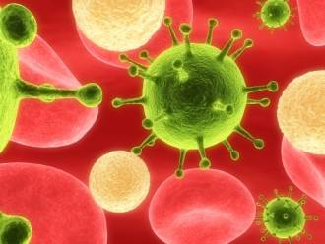
For the invading organism to be ‘infectious’ depends on:
Amount of the invading organism present at exposure time
length of time the host is exposed to the organism
Person’s overall physical and emotional health and the body’s ability to fight off the infection

Slide 30
Steps of Infection Control
Primary goal is to protect others from infectious diseases
Second goal is to provide early detection, intervention & referral

Slide 31
Preventative Methods
Standard Precautions
Immunizations
Early Detection, Intervention & Referral

Slide 32
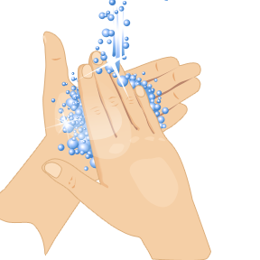
A. Standard Precautions
Meant to reduce transmission
Protect both DSP’s and person infected
Used for all persons at all times
Protective barriers: gloves, masks, gowns
  Needed when contact w/ blood or body fluids is likely
Hand Hygiene: most important technique is to wash hands
Avoid Accidental Cuts
Environmental Controls - Usually routine house-cleaning will be enough

Slide 33
Discuss Procedures for:
Contaminated surfaces
Cleaning contaminated food surfaces
Contaminated laundry

Slide 34
MRSA
Methicillin-resistant Staphylococcus aureus
  Common bacteria referred to as a ‘Super Bug’
Spread by:
  Direct contact with infected person, sharing personal items, touching surfaces with MRSA on it
  Persons undergoing invasive surgery, weak immune systems
  Etc.
Signs: bump or infected area that’s red, swollen, painful, warm to touch, has pus or drains, fever

Slide 35
Accidental exposure incidents
Basically blood or body fluid exposure
Eyes, nose, mouth
  Flush exposed area w/ fresh water 3-5 minutes
Needle stick or skin break
  Wash with soap & water 3-5 minutes
Notify supervisor/nurse/ doctor

Slide 36

B. Immunization
Vaccines:
  DPT, MMR, Hep B, Polio Vaccine
C. Control thru Early Detection, Intervention, & Referral
DSP’s may be the first to notice changes –
Report to supervisor / nurse
  Ongoing tracking/monitoring/ reporting

